Slide 1





01/09
Studio Shodwe
SAFEHER – WOMEN SAFETY AWARENESS PLATFORM
SAFETY, AWARENESS & EMPOWERMENT AT YOUR FINGERTIPS
TEAM NAME: TEAM BUBBLES
GAURI SACHAN 23BCE11252
TANUSI BANSAL 23BAI11033
SAANYA GARG 23BCE11295
DEEPAK SHUKLA 23BCE11422

Slide 2
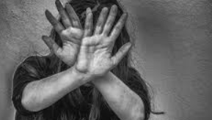
02/09
Studio Shodwe
Women face cyberbullying, harassment, and unsafe offline situations daily.
Existing tools are scattered, not beginner-friendly, or lack real-time emergency features.
Survivors of cyberbullying often don’t have spaces for healing & confidence rebuilding.
PROBLEM
STATEMENT

Slide 3

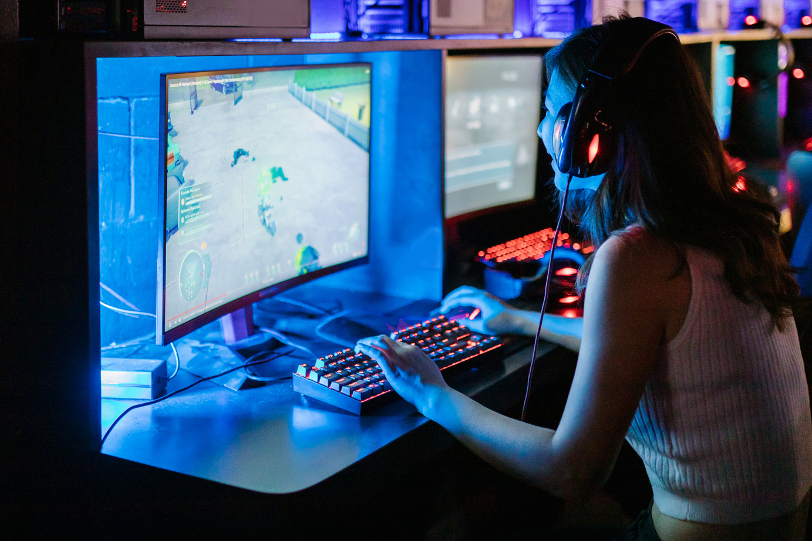

03/09
Studio Shodwe
WHY
SAFEHER
Over 70% of women experience harassment online or offline.
Many are unaware of makeshift safety solutions at home.
Need for a one-stop platform that combines awareness, prevention, and support.

Slide 4

04/09
Studio Shodwe
SafeHer is an *all-in-one platform* that provides:
One-Click Emergency Button → Call Police HQ instantly
*Safety Videos & Self-Defense Tutorials
DIY Home Safety Hacks
News & Articles on women’s safety
Motivational Space for survivors of cyberbullying
Anonymous Reporting
OUR
SOLUTION

Slide 5



05/09
Studio Shodwe
Emergency Button with saved local police number
Knowledge Hub (videos, guides, awareness content)
DIY Safety Items (household alternatives for protection)
Motivational Section → stories & support
Anonymous Reporting Tool
KEY
FEATURES

Slide 6
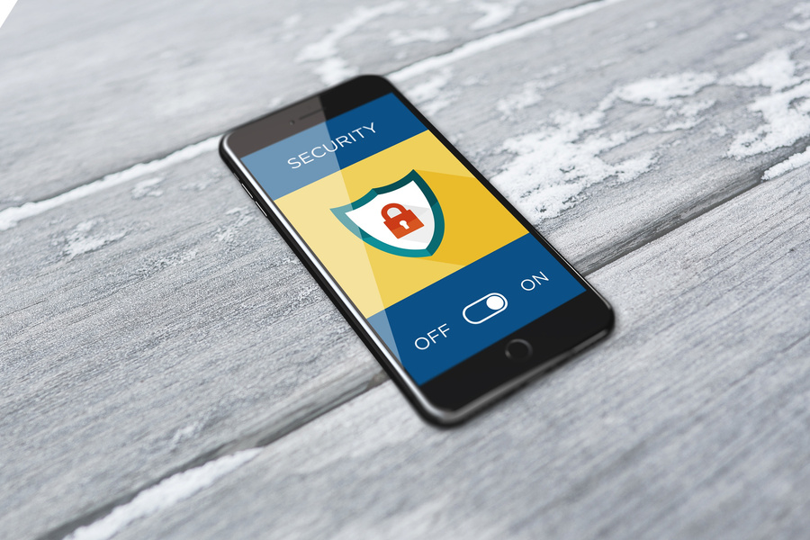



06/09
Studio Shodwe
TECHNOLOGY
STACK
Frontend
storage
HTML, CSS, JavaScript
LocalStorage for prototype
Backend
Mobile first approach
Node.js, Express, MongoDB for reports & data
PWA (installable web app)

Slide 7

07/09
Studio Shodwe
FUTURE
ROADMAP
Backend reporting system with police/NGO alerts
Multilingual support (Hindi, regional languages)
Mobile app (PWA/React Native)
Partnerships with NGOs, police & women’s helplines
AI-based cyberbullying detection

Slide 8


08/09
Studio Shodwe
IMPACT
*Empowerment: Women learn to defend & protect themselves
Accessibility: Free, easy-to-use interface
Safety: Quick emergency help at fingertips
Community: Motivational space to heal & inspire

Slide 9
09/09
Studio Shodwe
THANK
YOU!

